Slide 1
PC613: Communication Skills
Sem I, MSc IT
Instructor: Dr. Jenson Joseph

Slide 2
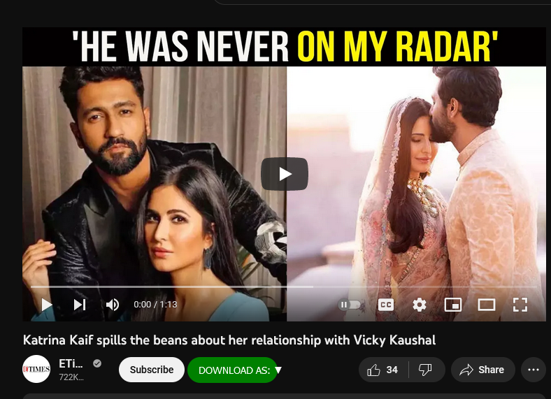
Learn an idiom
“To spill the beans/tea”

Slide 3
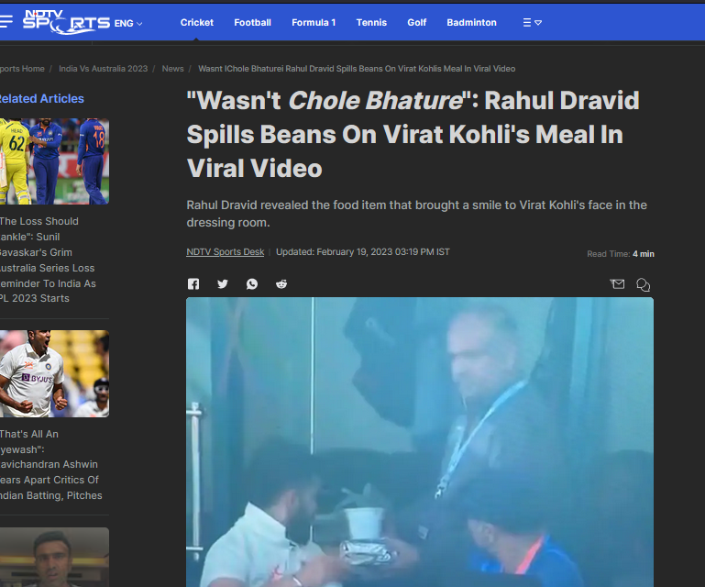
Learn an idiom
“To spill the beans/tea”

Slide 4
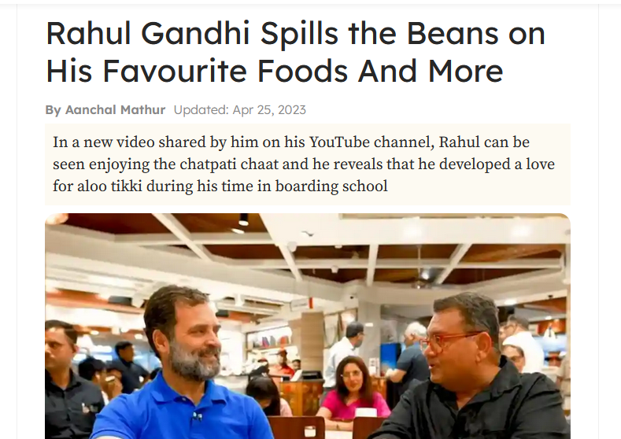
Learn an idiom
“To spill the beans/tea”

Slide 5
Learn an idiom
“To spill the beans/tea”
“to spill the beans” or “to spill the tea” means:
to gossip
to reveal information that was not meant to be made public
to open up
Examples:
I shouldn’t spill the tea, but have you heard that Rahul and Priya are dating?
Come on, spill the tea. Tell me what you know about Arjun!
I’ll spill the beans. There’s going to be a huge party and no one has invited Mr. Patel.
So come on, spill the tea. You know everything that happens in the hostel.

Slide 6
Goodbye Party for Miss Pushpa TS
Poem by Nissim Ezekiel
Surat? Ah, yes,
once only I stayed in Surat
with family members
of my uncle's very old friend-
his wife was cooking nicely…
that was long time ago.
Coming back to Miss Pushpa
she is most popular lady
with men also and ladies also.
Whenever I asked her to do anything,
she was saying, 'Just now only I will do it.'
That is showing good spirit.
I am always appreciating the good spirit.
Pushpa Miss is never saying no.
Whatever I or anybody is asking
she is always saying yes,
and today she is going
to improve her prospect
and we are wishing her bon voyage.
Now I ask other speakers to speak
and afterwards Miss Pushpa
will do summing up.
Friends,
our dear sister
is departing for foreign
in two three days,
and we are meeting today
to wish her bon voyage.
You are all knowing, friends,
What sweetness is in Miss Pushpa.
I don't mean only external sweetness
but internal sweetness.
Miss Pushpa is smiling and smiling
even for no reason but simply because
she is feeling.
Miss Pushpa is coming from very high family.
Her father was renowned advocate
in Bulsar or Surat,
I am not remembering now which place.

Slide 7
Proper use of Present Tense forms
The ‘present simple’, ‘present continuous’ and ‘present perfect’ tenses
Present simple tense for:
things that we do regularly,
for facts,
for habits, truths,
permanent situations.
Used in combination with time expressions like every day, once a week, on Fridays, and so on...
Examples:
I check my email every day. (regular activity)
Urvashi studies well/studies in DA-IICT. (fact/permanent situation)
Jetal and Rishi speak well. (fact/habit/truth)

Slide 8
Proper use of Present Tense forms
Present simple: form
When the subject is I, you, we or they, for positive sentences, use the verb in the infinitive form without 'to'.
For he, she and it, add -s or -es to the infinitive.
Make questions and negatives with do / does + the infinitive form of verb without 'to'.
More examples
They live in Europe.
Tulsi wakes up at six o’clock and goes to bed at ten. But Pranay starts his day late.
I don't eat smoke or drink. I don’t eat meat either.
It doesn't usually rain in May.
Why do you check your phone for messages all the time?
Does the supermarket sell beer?

Slide 9
Proper use of Present Tense forms
Present continuous: our favourite tense! ☺
Used for:
things that are happening at the time we are speaking,
for temporary situations,
and for activities that are in progress.
Examples:
Just a minute. I’m checking my email. (now)
She usually works in Ahmedabad, but she’s working from home this week. (temporary)
I’m studying MSc IT. (activity in progress)
We can also use the present continuous for future arrangements, usually with a time expression.
I'm seeing the doctor on Monday morning.

Slide 10
Proper use of Present Tense forms
Present continuous: form
For positive sentences, the form is subject + am/is/are + verb-ing.
Make questions and negatives with am/are/is + not + verb-ing.
More examples:
Can I call you back later? We’re having dinner right now.
He isn’t answering his mobile at the moment.
What are you reading? What are you planning to do in the evening?
Is it raining?
Note that we don’t usually use some verbs in the continuous form:
for example: hear, see, smell, hate, know, understand, want, need.
WRONG: Could you explain that again? I’m not understanding. CORRECT: Could you explain that again? I don’t understand.

Slide 11
Proper use of Present Tense forms
Present Perfect
Use present perfect for:
Life experiences in the past: We don’t say when these happened; we are interested in the experience, not the time or date.
Past Perfect is often used in combination with ever and never, or all.
Examples:
I’ve seen all Alia Bhatt’s films. I have seen Sholay several times. I have seen DDLJ in Maratha Mandir.
Have you ever eaten sushi? - Yes, I have. / No, I haven’t.
Present perfect is also used for recent past actions that are important now.
Examples:
Oh no! I’ve left my wallet on the bus.
The president has resigned.

Slide 12
Proper use of Present Tense forms
Present Perfect
Also used for past situations that are still happening now. Examples:
I haven’t seen Sanket this morning. (It is still this morning.)
How long have you known Sakshi? - I’ve known her for two years.
Abdulla has been in Ahmedabad since 2010.
Present Perfect is also used with just, already, yet--to talk about recent events in the past, when the exact time is not important.
Use just and already mainly in positive sentences. Use yet in negatives and questions. Examples:
It has just stopped raining. Let’s go out.
Can you feed the cat? -- I’ve already fed her.
We can still watch the film. It hasn’t started yet.
Have you done your homework yet?

Slide 13
Proper use of Present Tense forms
Present Perfect: Form
For positive sentences, the form is subject + have/has + past participle.
Make negatives with not and change the word order to make questions.
More examples:
I've finished the report.
Neel has been in Gandhinagar since last month.
We've just got back from Germany.
I haven’t seen Vraj this morning.
How long has Abdullah known Krishna?
Note: Use the past simple for completed actions in the past.
I saw Sanket yesterday.
Vraj moved to Surat in 2020.
Krishna didn't want to come to class / drink coffee.
When did you see Rishi?

Slide 14
https://www.youtube.com/watch?v=G2wkO0DhpEY
https://www.songlyrics.com/ella-fitzgerald-louis-armstrong/you-say-tomato-i-say-tomato-lyrics/
Brick in the wall:
https://www.youtube.com/watch?v=axWVMr-RpMM
https://www.songlyrics.com/pink-floyd/another-brick-in-the-wall-lyrics/

